Slide 1










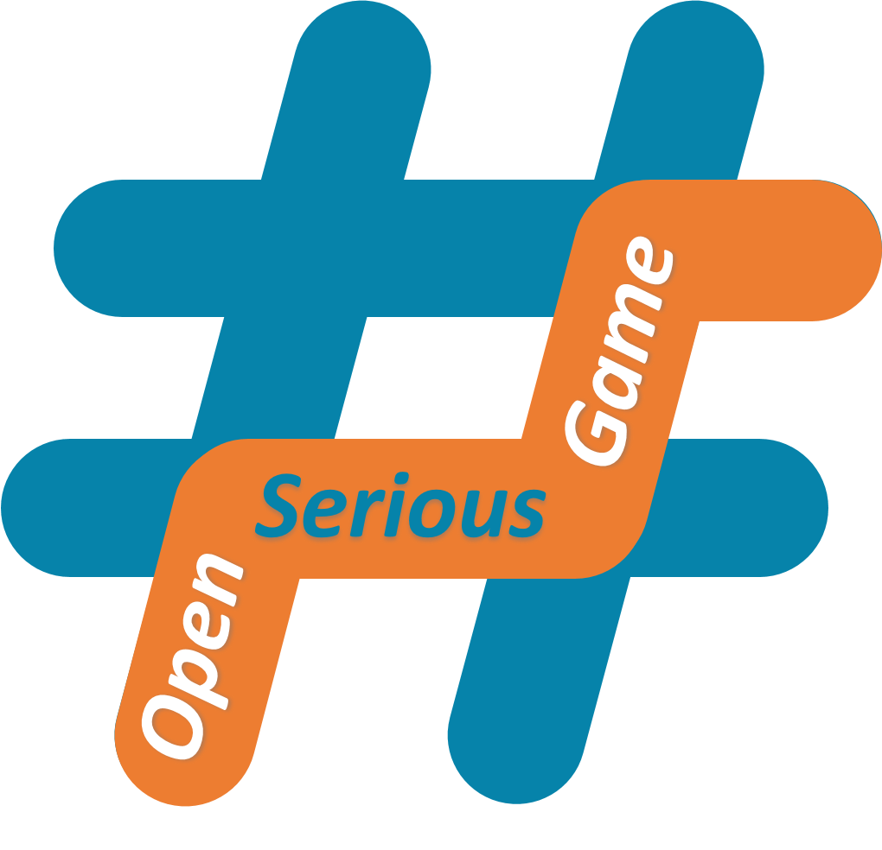
W5 Community Level Design Workshop
Let members earn their way within the Community
Gamify progression in Community
For Community Boosters mostly

Slide 2
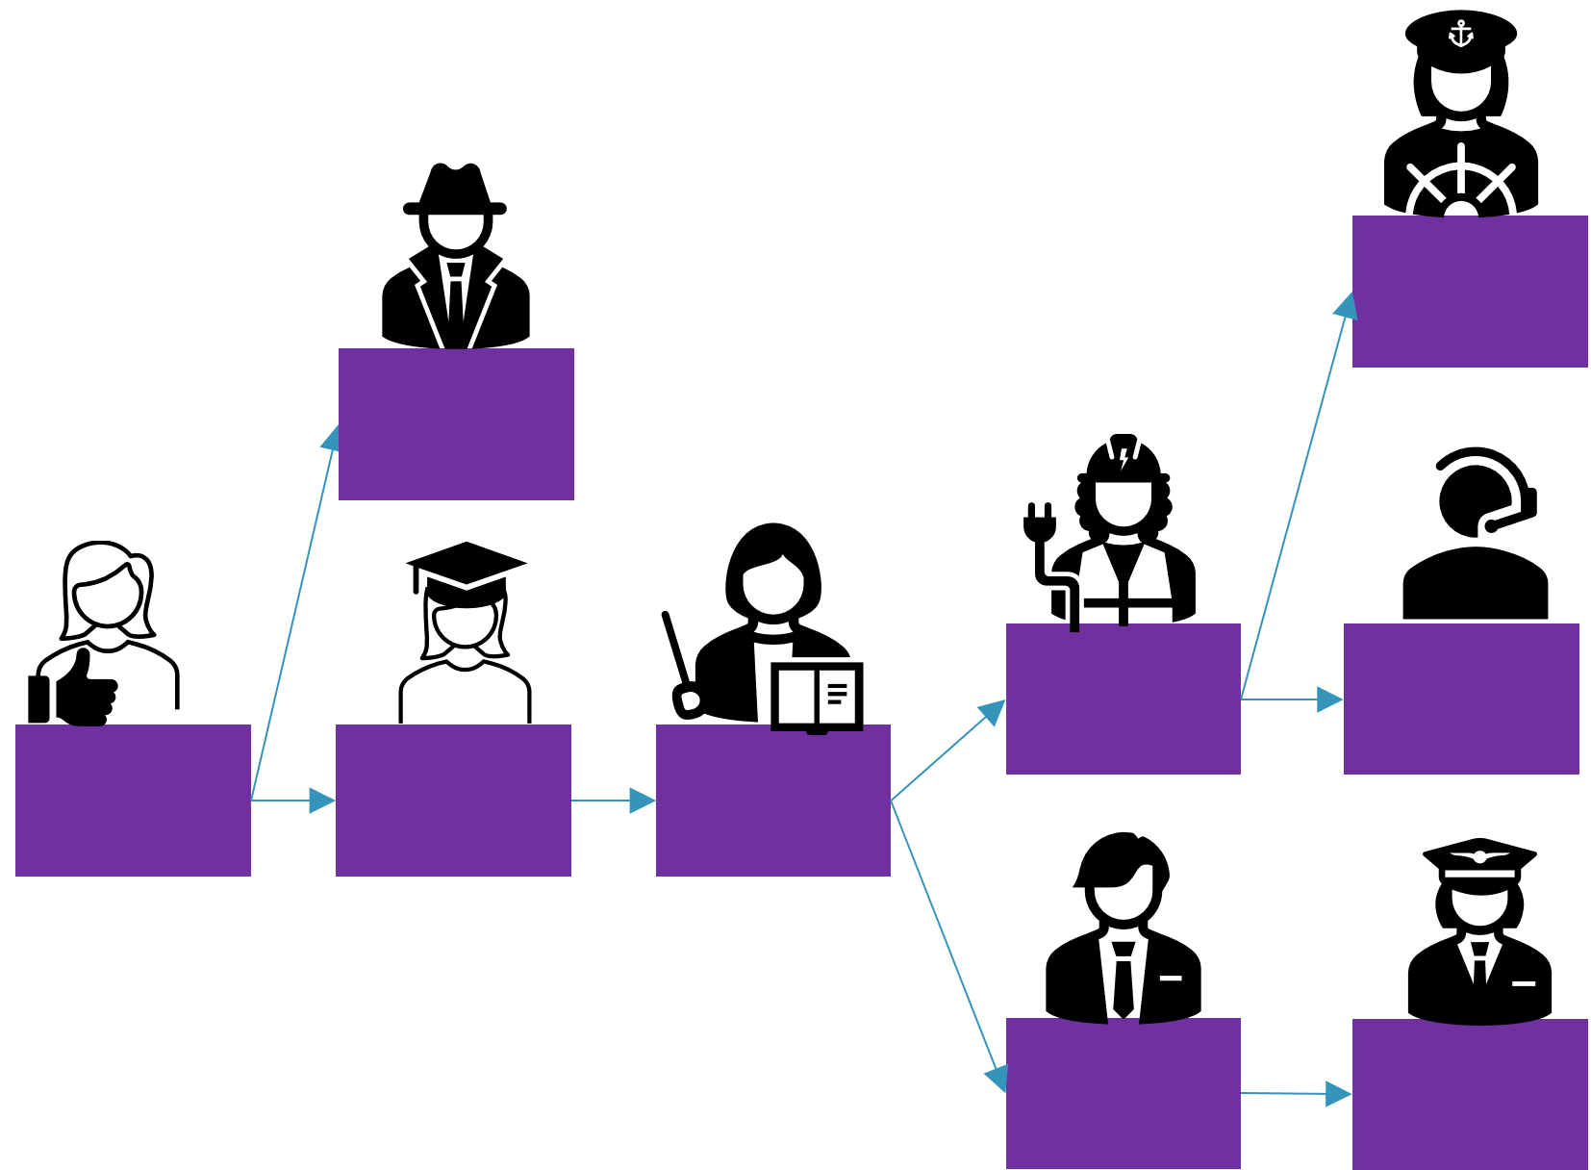
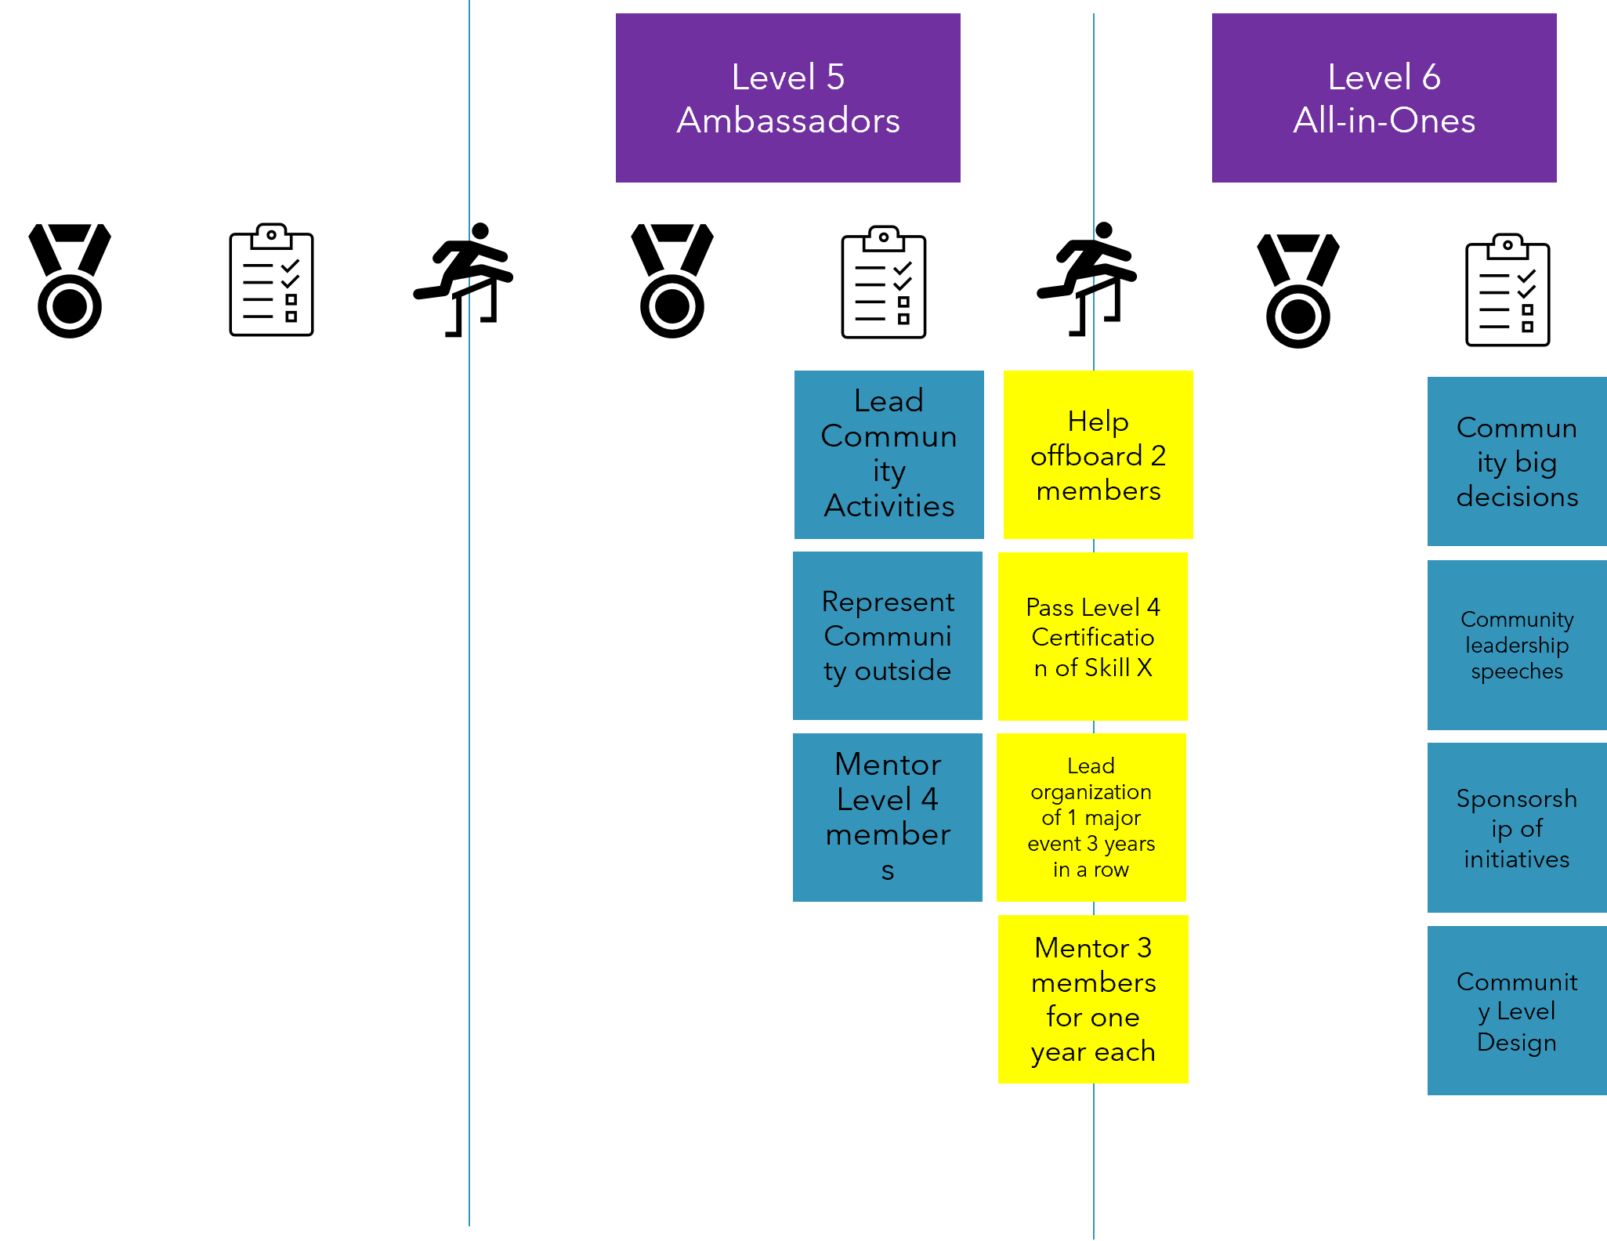
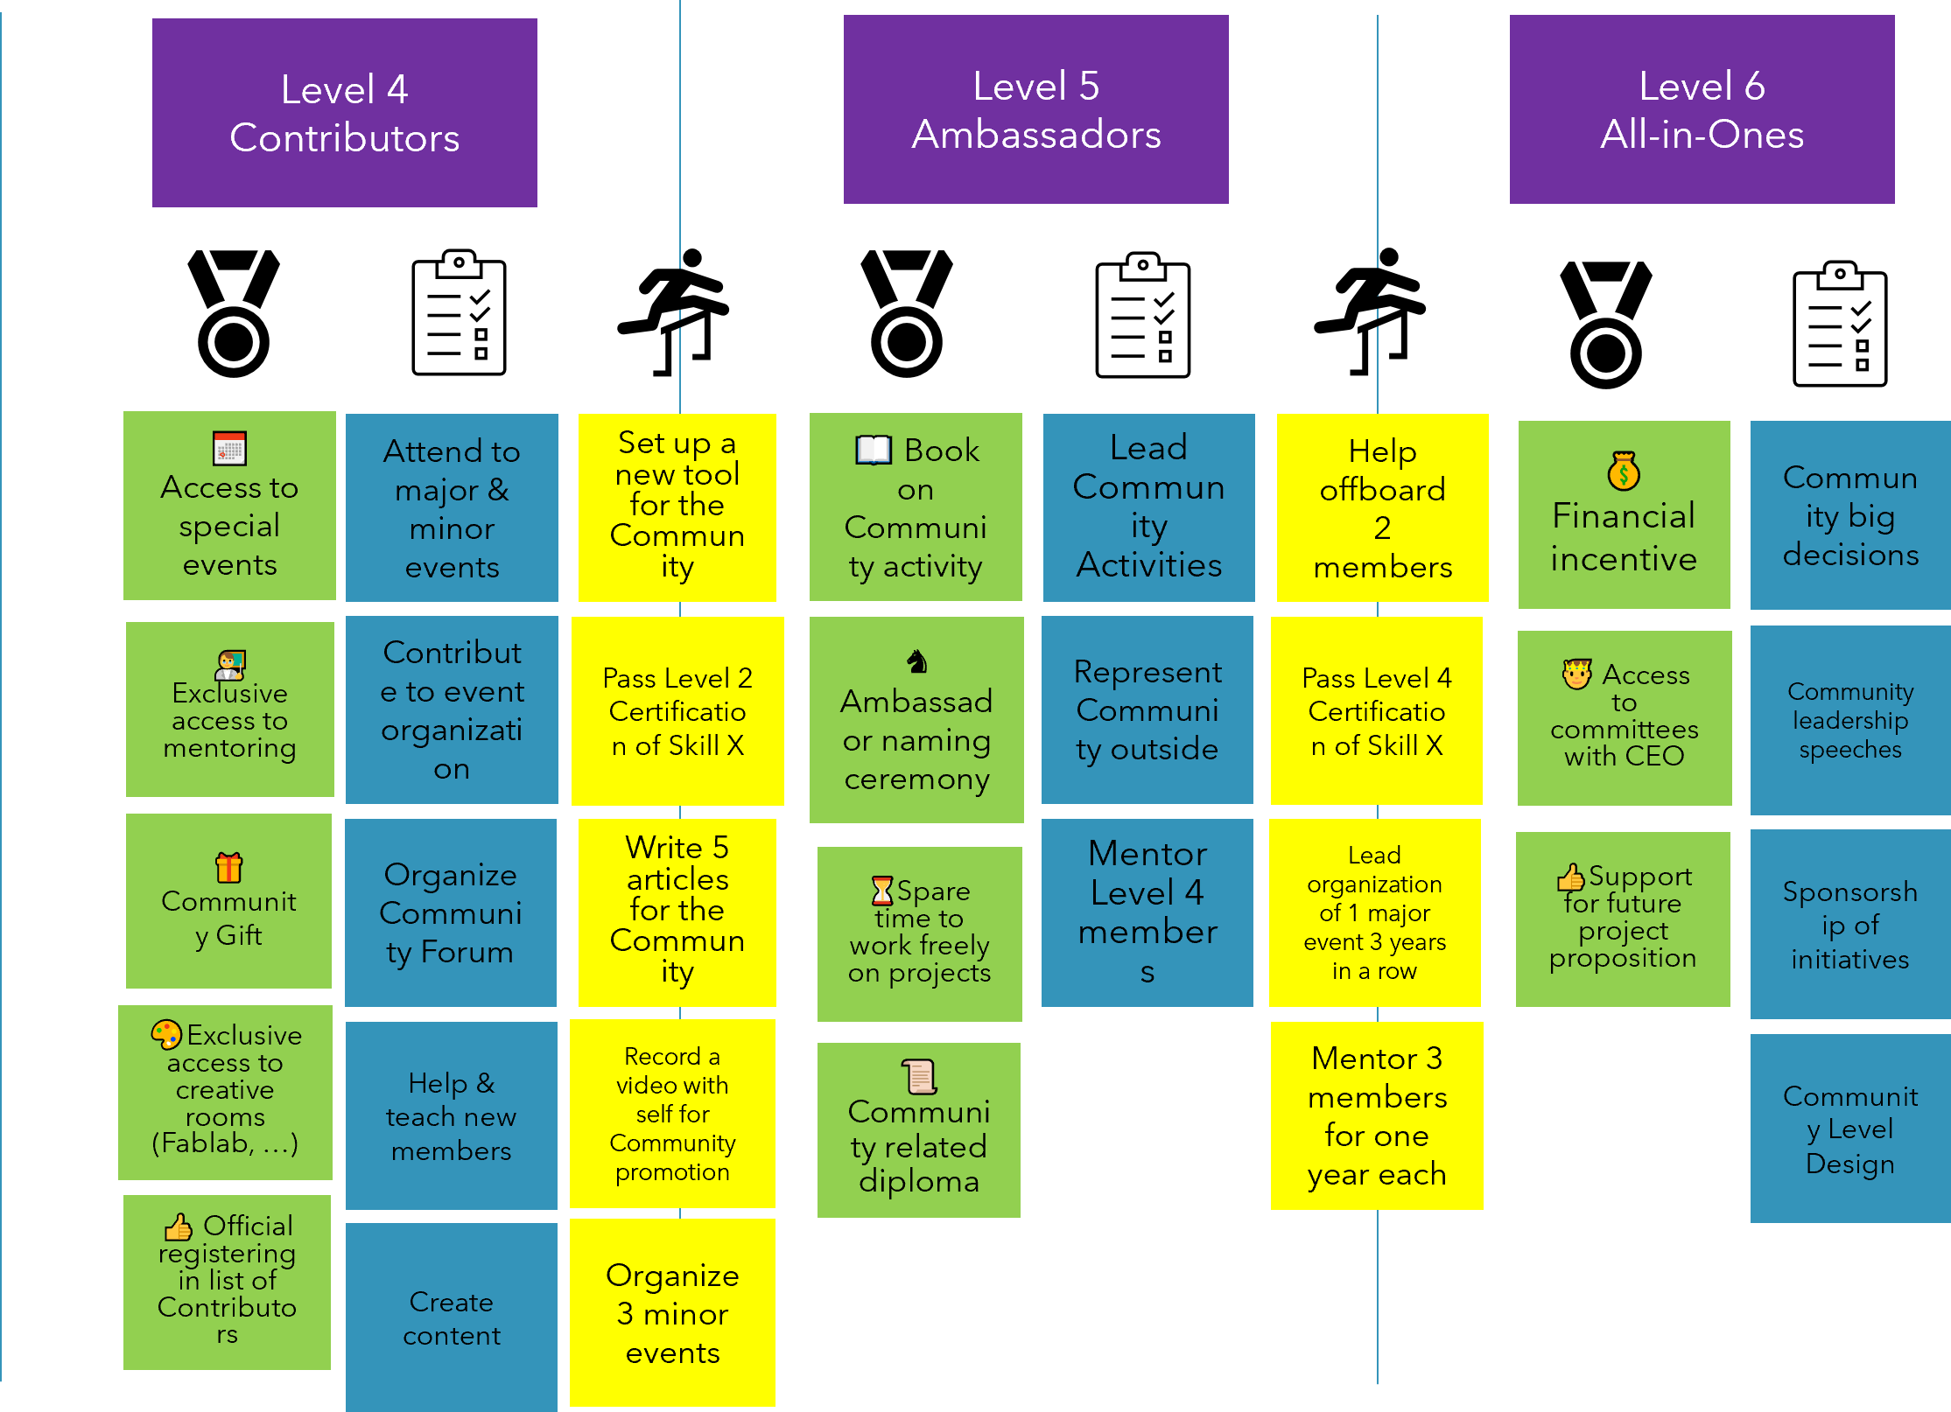
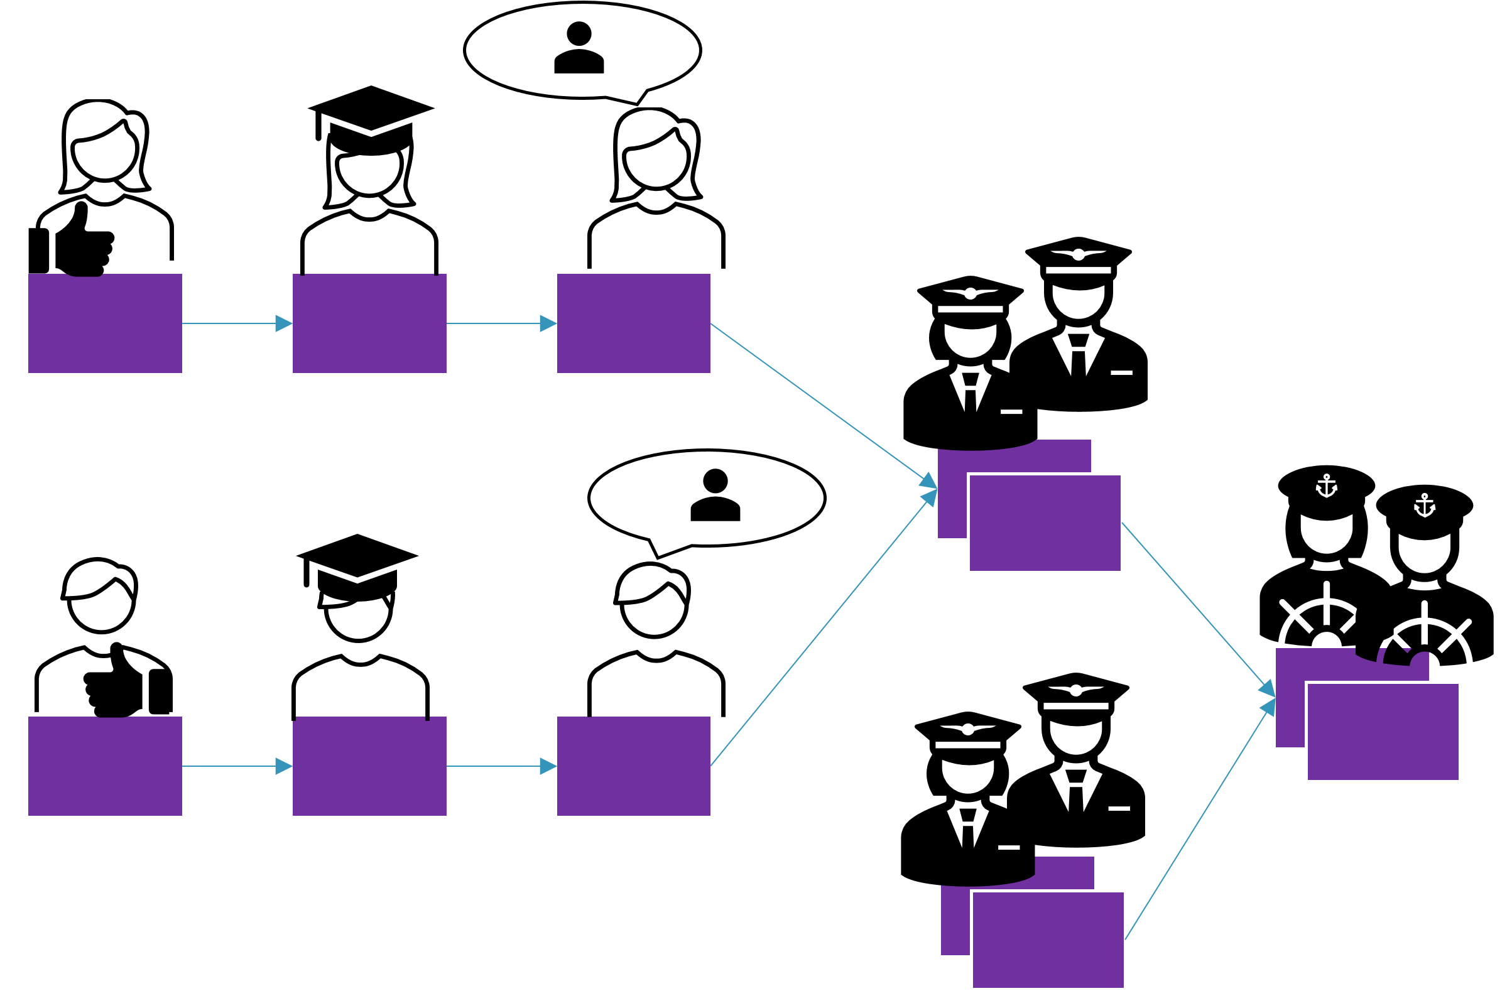

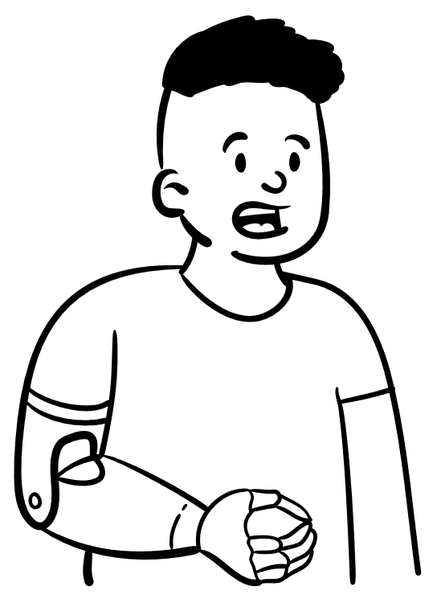


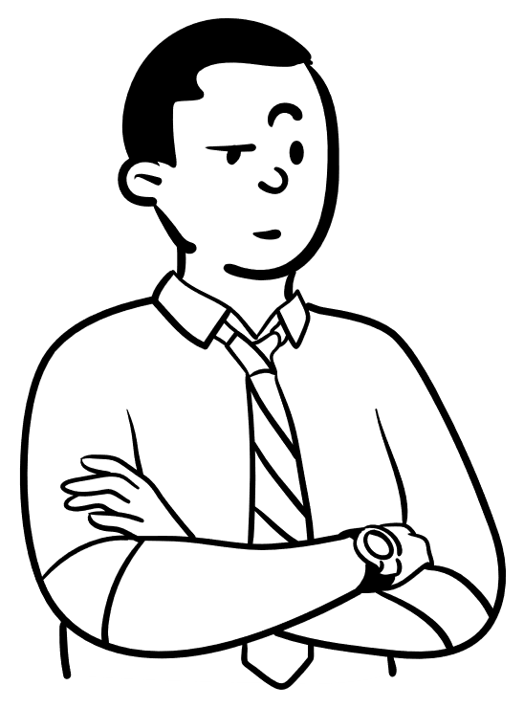
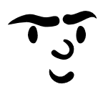

Level 1 : Community Level Design Workshop in a Nutshell
Participants share about Communities they know in which there are levels
Together, participants define Community levels, starting from the top level and necessary intermediary levels to get there.
If relevant, participants can add customized Community rewards when members reach given levels. Iterate until obtaining a satisfying level design for the Community.

Slide 3
Inspiration : Communities with levels

Slide 4
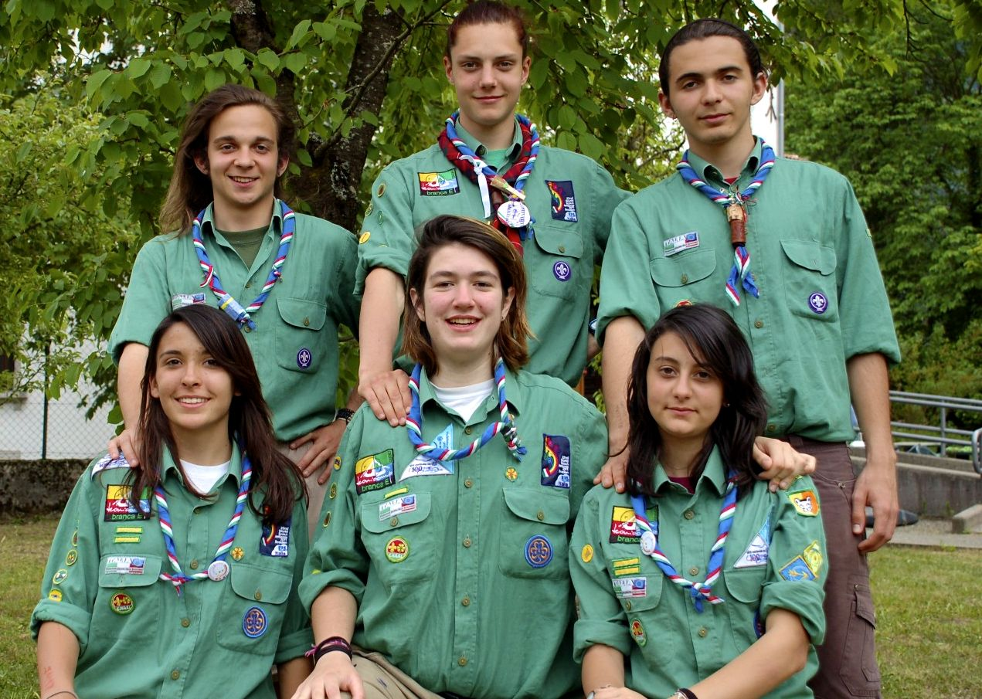
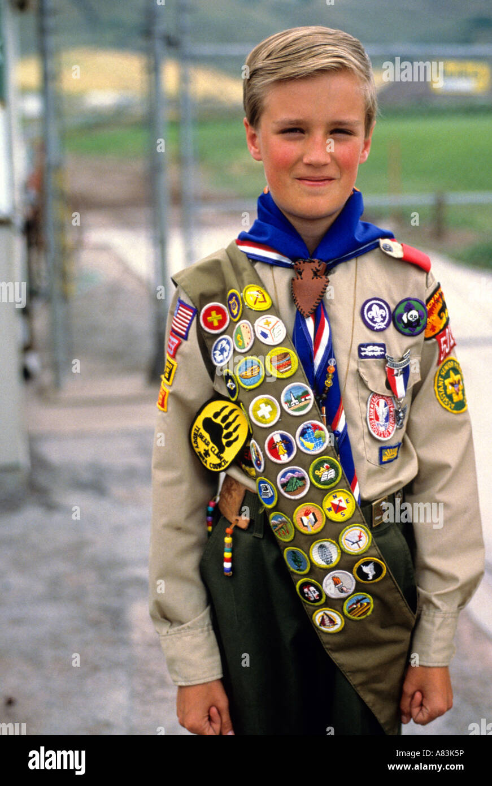
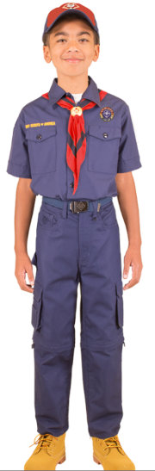
Examples for Inspiration Example : Levels in Scout Groups
Rover Scout
Ranger Guide
Boy Scout
Girl Scout
Wolf Cubs
Brownie Guide
https://en.wikipedia.org/wiki/Scouting

Slide 5
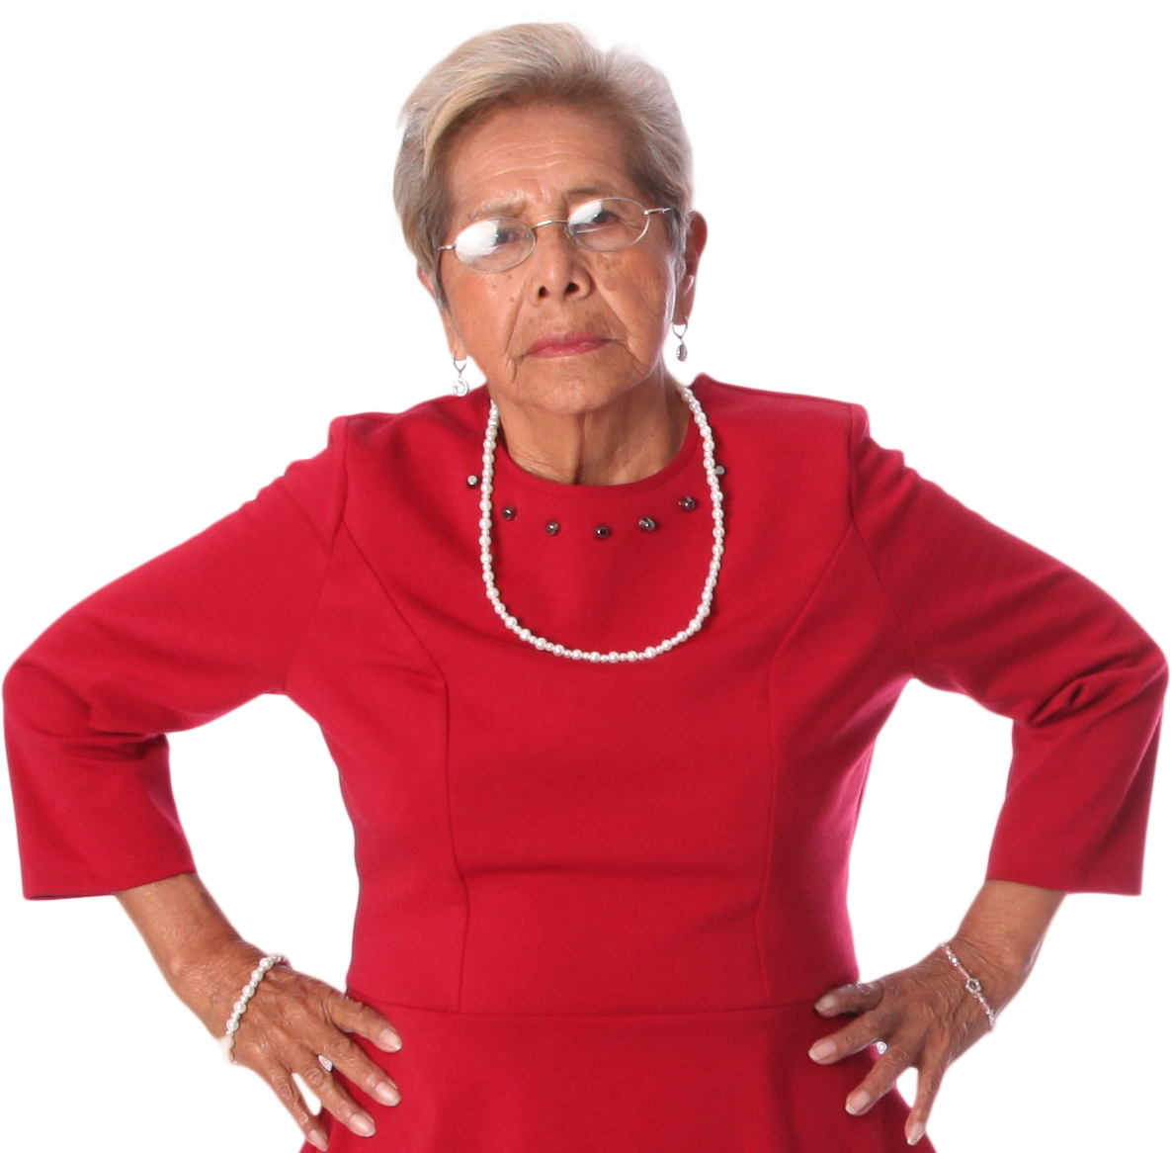


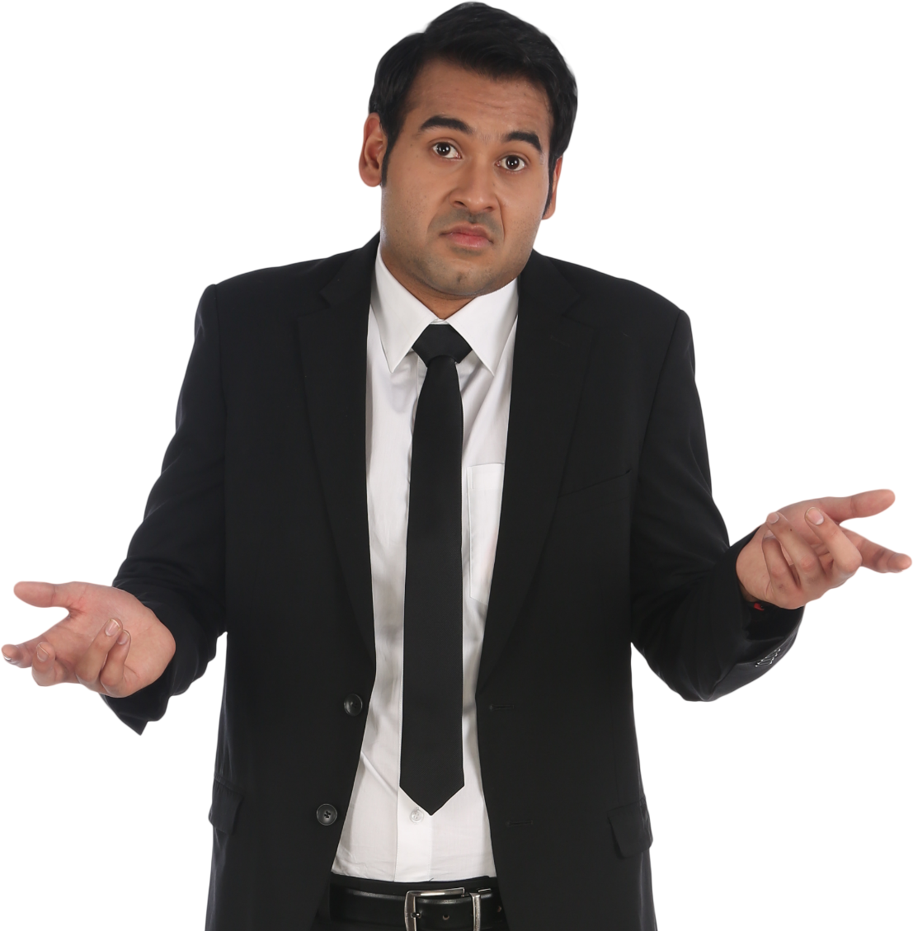

Examples for Inspiration Example : Levels in a Consulting Company
Partner
Manager
Senior Consultant
Consultant
Analyst

Slide 6
















Examples for Inspiration Example : Levels in #OpenSeriousGame Movement
Creator
Create events with content
Host
Host events
Co-Host
Co-host events
Scout
Promote events with content
Player
Attend events
Curious
Checks content

Slide 7
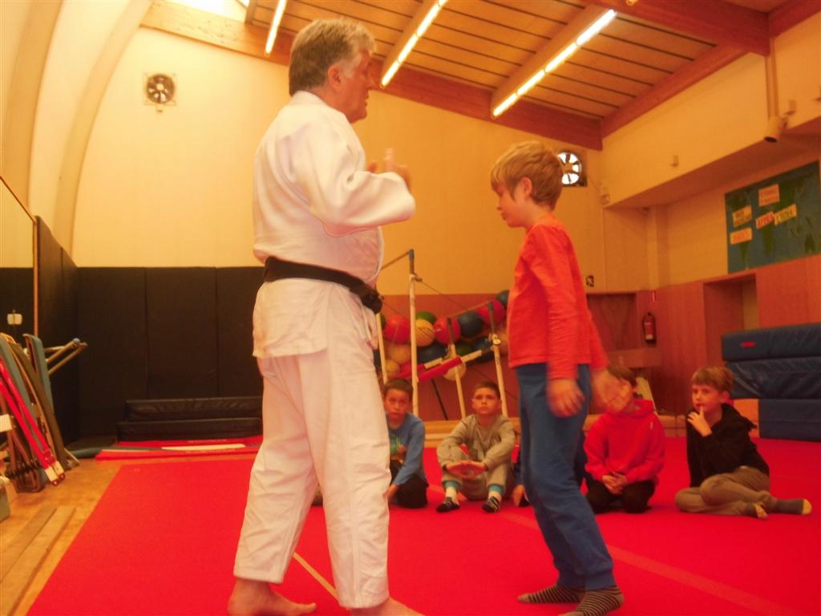
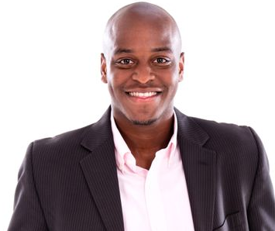
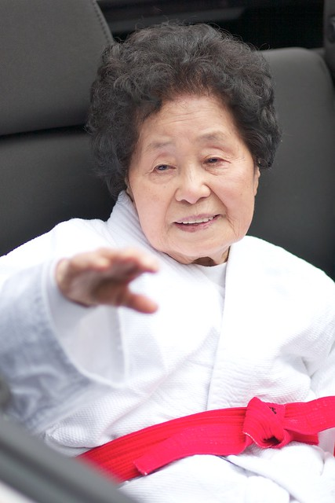
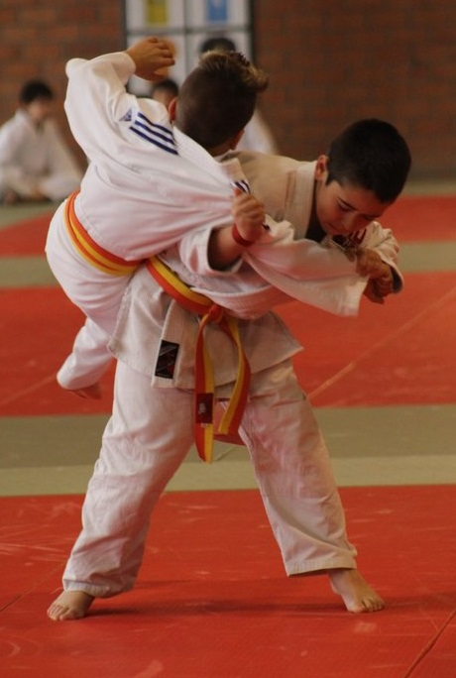
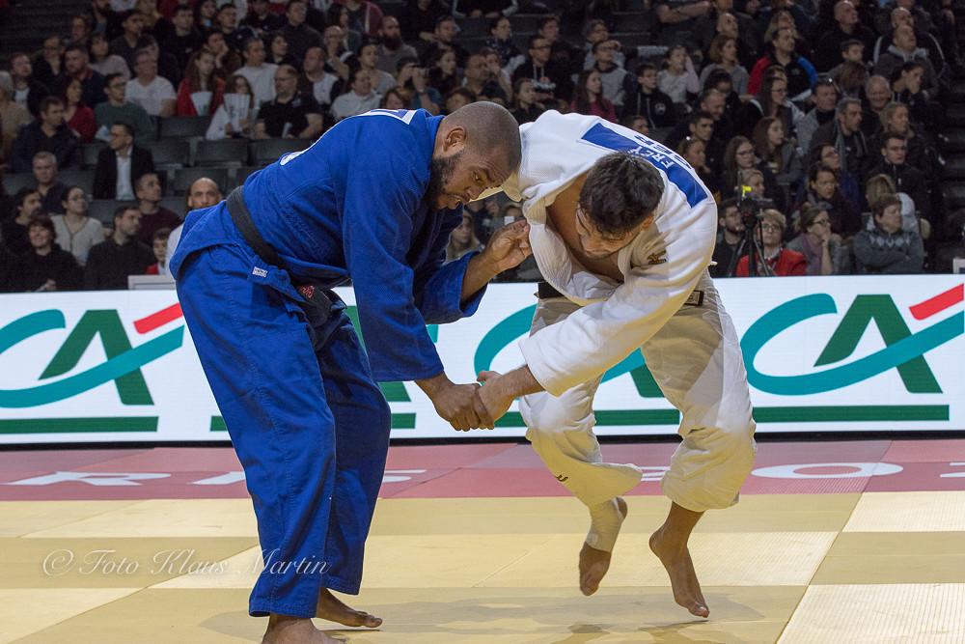
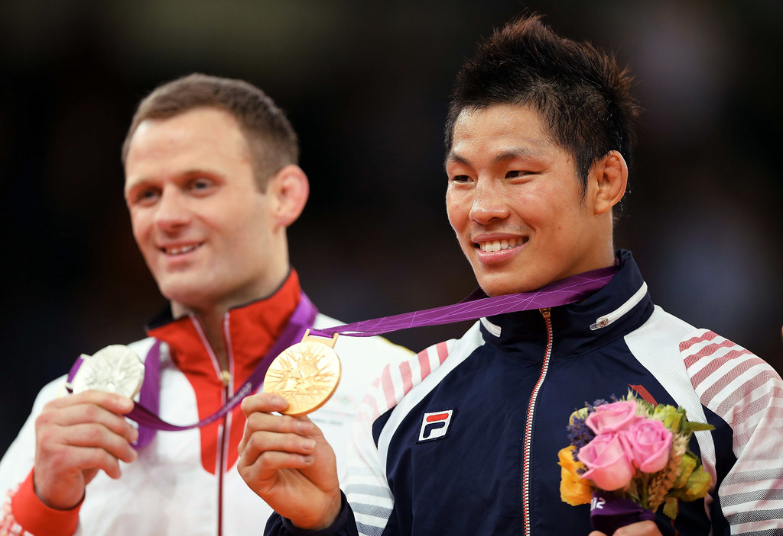
Examples for Inspiration Example : Levels in Sports Club
Club President
Club Instructor
Sport Veteran
Trainee
Professional practitioner
Top League professional competitor

Slide 8
Your Turn
Other Communities
What other Communities with levels do you know ?
What are the benefits of the level system in these Communities ?
In these communities, how can members move from one level to another ?
What are the rewards and challenges for arriving at these levels ?
What is the way to recognize a member is from a specific level ?
Your Community Potential
What could be the benefits of a level system for your Community ?
Without details on the levels, which members would you imagine right now in the most advanced levels ? In medium levels ? In least advanced levels ?
What could levels mean for your Community ? (in other words : What would the main differences between a very high level in your Community and a very low level)
What rewards and challenges could be interesting of for your Community ?

Slide 9
Level Design Workshop

Slide 10
Level 2 : How Community Level Design Workshop is conducted
 | 1 Introduction | 2 Example result | 3 Define activities 🟦 and levels🟪 | 4 Define rewards🟩 and challenges🟨 | 5 Global review of a path | 6 Share & Brainstorm about the future
Suggested timebox | 5 minutes | 20 minutes | 25 minutes + 10 minutes Break | 40 minutes | 10 minutes | 10 minutes
Action | Explain purpose of the workshop : Promote Engagement in Community Establish a step-by-step experience for members Become fair about Community progression Share about mindset : Fairness first Acceptance that not all members are equal in contribution (not guilting anyone), and Remember to base rewards and challenges on your own knowledge of members motivations and skills | Show example results to inspire: Ideas of levels Ideas of rewards Ideas of challenges It is up to you to Define paths Select rewards and challenges Invite whoever you think is relevant to the Community | The most advanced level represent what a member does when he/she has progressed through ALL the Community levels. Therefore, it is the paragon of members and must represent an ideal. Define activities 🟦 of the most advanced level🟪 Name the most advanced level 🟪 Define the second most advanced level🟪🟦 Continue down to the entry levels In case of several branches, finish one full path from ideal to beginner before starting another one. | For each level 🟪, choose or define challenges🟨that are necessary to perform to reach the next level🟪. Start with beginners. Once you finished a first round of challenges, start from the top level 🟪 and define the rewards 🟩 During this exercise, feel free to adjust activities 🟦 and level names🟪 It is normal to go back and forth and iterate. | Tell a story of a beginner🟪 in the Community to his advanced/level🟪. In case of inconsistencies or possible improvements, adjust your 🟪🟦🟩🟨 It is recommended to perform this global review once again a few days after the workshop | Discuss on implementation : Where will the path be published ? Who should review it before publishing ? What is hidden (surprise rewards for example), what is shown ? Organize FAQ session about the Community levels Check the “Using the workshop results” slide

Slide 11



Community level Design Example of workshop results
✅Base activities
What is the experience at this level
🎖️Growth challenges
What is necessary to gain access to next level
🎖️Community Rewards
What rewards members get for going up a level
Level 1
Bystanders
Level 2
Followers
Level 3
Rookie
Level 4
Contributors
Level 5
Ambassadors
Level 6
All-in-Ones
Read posts
Attend 3 events in a row
📛 Community BADGE
Attend major events
Bring 3 people to 2 events (total 6)
🍛 Invitation to quarterly dinner
Share content
Contribute in 1 major event organization
📅
Access to special events
Attend to major & minor events
Set up a new tool for the Community
📖 Book on Community activity
Lead Community Activities
Help offboard 2 members
💰 Financial incentive
Community big decisions
React to articles
Subscribe to newsletter
🎫 Community Lottery ticket
Discuss in Forum
Write 2 promotional articles about the Community
📚 Exclusive access digital library
Organize small groups of attendees in event
Pass Level 1 Certification of Skill X
👨‍🏫 Exclusive access to mentoring
Contribute to event organization
Pass Level 2 Certification of Skill X
♞ Ambassador naming ceremony
Represent Community outside
Pass Level 4 Certification of Skill X
🤴 Access to committees with CEO
Community leadership speeches
Discover community activities
Answer to 4 polls
Meet members
Help in Community onboarding
Answer to 25 questions in Community Forum
🎁 Community Gift
Organize Community Forum
Write 5 articles for the Community
⏳Spare time to work freely on projects
Mentor Level 4 members
Lead organization of 1 major event 3 years in a row
👍Support for future project proposition
Sponsorship of initiatives
🎨Exclusive access to creative rooms (Fablab, …)
Help & teach new members
Record a video with self for Community promotion
📜 Community related diploma
Mentor 3 members for one year each
Community Level Design
👍 Official registering in list of Contributors
Create content
Organize 3 minor events

Slide 12

Community level Design Visual step by Step
🟪🟦
1. Define the most advanced level (name and activities). If you lack inspiration, check resources.
2. Define the level before the most advanced level
3. Define the other levels
4. Iterate and adjust the 🟪levels and 🟦activities before going further
🟪🟦🟩🟨
5. Define the 🟨 challenges to move up starting with beginner level. If you lack inspiration, check resources.
6. Add the rewards for achieving these challenges (note : check warnings on rewards). If you lack inspiration, check resources.
7. Complete repeating the same step to the last level
8. Iterate and adjust the 🟪🟦🟩🟨 until time is up or when you reach a satisfying testable version

Slide 13
Using the workshop results
☑️Review the results a few days after to take some hindsight
🤝Review with Community Sponsor (Clarify Governance, validate rewards, …)
📣Identify where, when, how, to whom, the levels should be shared
✨Beautify and make the result fun and engaging (in the format)
⚒️Decide on implementation tools and processes : When, where, who, how will you track members levels (example : use workshop 6 #OpenSeriousPath)

Slide 14
Questions to ask yourself on rewards
Should the reward be more external or internal ? (Warning : Excess of external rewards can have negative effects over time)
Should a given reward be 🧍individual or 🧑🏽‍🤝‍🧑🏻 collective ?
Individual rewards can foster individualistic behavior
Collective rewards can be slower to implement
Should it be known beforehand by members (can trigger reward-driven behavior) or unknown beforehand and given by Community Booster only after challenges are completed ?
Should it always be the same reward for all or should it depend on the person ? If the latter, among what shortlist would you pick ?

Slide 15
Questions to ask yourself on growth challenges
Should a challenge be 🧍individual or 🧑🏽‍🤝‍🧑🏻 collective ? Or collective beyond a certain level ?
How can you make a challenge meaningful (difficult enough but not too difficult, useful for the Community, …) ?

Slide 16
From one Path to many paths
In case of high diversity in Community Profiles, you can choose to set up different paths instead of one
🗺️Mostly apply to larger communities than to small communities
Adding several paths allows more alignment between levels and members preferences, but also adds more complexity in Community Management

Slide 17




Multiplayer level design
Single player level design can create competitive side effects, which can be damageable
Multiplayer level design insists on the necessity of cooperation and collaboration to succeed on collective challenges and receive collective rewards.
You can include challenges that require cooperation, and levels that can be reached only collectively

Slide 18
Workshop resources
🟪Roles, 🟨Challenges, 🟩Rewards, ↗️ Usual progression paths

Slide 19


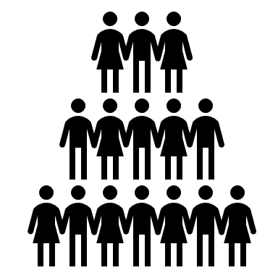




Usual progression paths
Increasing skill level
Increasing level of responsibility
Common core and specialties
Individual then collective

Slide 20
Optional preparatory workshop : Pre-define level rewards based on members motivations. Ideas for Community rewards
external motivations internal motivations
🎁Material possessions
🥇Social recognition
✨Stimulation & Well-being
🤝Bonding with others
🎗️Positive Impact & meaning
🏋️Skill development & achievement
⏳Freedom & Free Time
💡Creative space
💰 Financial incentives
📛 Badges
🎲 Participation to games
🥂 Celebration moments
💰 ❤️ Financial reward to give to non-profit
🔑 Access to training courses
⏳Spare time to work freely on projects
🎨Exclusive access to creative rooms (Fablab, …)
🎁 Gifts
🦚 Official titles in the organizational chart
📅 Tickets to Innovation events
🎁 ❤️ Gift to offer to someone of choice
🎁 ❤️ Gift to offer to someone of choice
📖 Books
👍Support for future project proposition
🎨Exclusive access to creative tools (creative pen display, drawing equipment…)
👕 Community themed Wearable (t-shirt, caps, …)
♞ Accolade / Coronation / title giving ceremony
💆 Personal services (massage, Yoga course …)
🎁 ❤️ Gift to offer to another member
👍 Statement or acknowledgment of contribution
👨‍🏫 Exclusive access to mentoring
🧹Logistics services (cleaning service, team extension …)
👍 Support for future project proposition (ex: bonus votes at arbitration event)
🍺 Community themed Goodies (mugs, USB key, …)
🤴 Exclusive access rights or decision rights / power
🤝 One-time access to VIP or difficult to access (President, …)
🙏Thank you cards
📚 Exclusive access to physical or digital library
🍛 Food and restaurant invitations
🔓Freedom to unfollow some existing rules or restrictions
📅 Allocated timeslot in large Community event for showcasing new project
💰 Community currency (loyalty points…)
📣 Promotional campaign about member
🙏Opportunity to serve other members
🙏Opportunity to serve others
📜 Community related diploma
🎫 Lottery tickets
🤴 Exclusive access rights or decision rights / power
👍 Contribution plaque (“This is here thanks to …”
🏋️ Statement of achievement
🎯 Access to bonus challenges
👕 Community themed exclusive Wearable (t-shirt, caps, belt…)
🎯 Exclusive access to bonus challenges

Slide 21
Examples of challenges & activities
✔️Perform Actions for current members-
🎓Develop Community related Skills
📣Act outside of the Community for the Community
✍️Create or curate content for the Community
🎯Serve Community purpose
📚Learn about the Community culture
👋Help in offboarding a (soon) former member
🚪Help in onboarding a new member
🎓 Learn about a Community related skill
📣 Help promote the Community (host or organize event)
💬 Start a discussion in Community Forum
✋ Perform actions for which the Community was created
🎓 Discover Community Artifacts (see #OpenSeriousCommmunity)
🤝Introduce members to each other
💁🏻Help a current member or group of members
✔️ Pass a Community exam about a Community related skill
💌 Bring new members in
📰 Write an article for the Community
🎤 Share results about Community purpose related actions
🛠️Set up tools and processes for the Community
❓Answer members’ questions in Community Forum
✔️ Pass an external exam about a Community related skill
🤝 Establish partnerships with the Community
📹 Record a video or a podcast or music
🤡Entertain the Community
🎤 Host or co-host a Community event
📤 Share knowledge about a Community related skill
🤝 Introduce members (as members) outside the Community
🗃️ Organize Community Wiki
🕴️ Represent the voice of the Community among members
📅 Help in the organization of a Community event
📧 Share Community related content
🎓 Create a training course / program for the Community
💬 Review, Comment, add likes, subscribe to the Community in outside platforms
👍 React to posts in Community Forum

Slide 22




Examples of basic (usually entry level) Community Roles
Curious Reactor
Student
Connector
Shadow
Micro-Contributor
Micro Hotline
👍 Read and react to posts in Community Forum
🎓 Learn about a Community related skill
🤝Introduce members to each other
📅 Attend a Community event
✋ Perform actions for which the Community was created
❓Answer members’ questions in Community Forum
📅 Attend a Community event
✔️ Attend an external exam about a Community related skill
🤝 Introduce members (as members) outside the Community
🎓 Follow a mentor as a Shadow to learn a Community related skill
📅 Help in the organization of a Community event
💁🏻Help a current member or group of members

Slide 23






Examples of intermediary (usually mid level) Community Roles
Community Recruiter
Community Godparent
Community Scout
Community
Mentor
Community Event Host or co-host
💌 Bring new members in
🤝Introduce members to godchildren
🤝 Introduce godchildren (as members) outside the Community
🕴️ Represent the voice of the Community among members
📤 Share knowledge about a Community related skill
🎤 Host or co-host Community events
🚪Help in onboarding new members
👋Help in offboarding godchildren
📅 Help in the organization of a Community event
🎓 Learn about a Community related skill
📣 Help promote the Community (host or organize event)
🚪Help in onboarding godchildren
📧 Share Community related content
❓Answer members’ questions in Community Forum
🎤 Share results about Community purpose related actions
💁🏻Help godchildren
📣 Help promote the Community (host or organize event)
❓Answer godchildren’ questions
💬 Start discussions in Community Forum

Slide 24



Examples of advanced (usually high level) Community Roles
Community Expert
Community Content Champions
Community OPS
Community Booster
Community Manager
🎓 Learn about a Community related skill
✔️ Pass an external exam about a Community related skill
📰 Write articles for the Community
📹 Record & edit videos or a podcast or music
🛠️Set up tools and processes for the Community
🤝Introduce members to each other
👋Help in offboarding members
🕴️ Represent the voice of the Community among members
🎤 Host or co-host a Community event
❓Answer members’ questions in Community Forum
💬 Review, Comment, add likes, subscribe to the Community in outside platforms
🗃️ Organize Community Wiki
🎓 Create a training course / program for the Community
📅 Help in the organization of a Community event
💬 Start discussions in Community Forum
🚪Help in onboarding new members
🤝 Establish partnerships with the Community
🤝 Introduce members (as members) outside the Community
✔️ Pass a Community exam about a Community related skill
📤 Share knowledge about a Community related skill
📧 Share Community related content
⚖️ Define rules within the Community
📣 Help promote the Community (host or organize event)
💁🏻Help a current member or group of members
🎤 Share results about Community purpose related actions
👍 React to posts in Community Forum
🎤 Host or co-host a Community event
❓Answer members’ questions in Community Forum
🤡Entertain the Community
⚖️ Define rules, manage arbitration and conflicts within the Community
🗃️ Organize Community Wiki
💌 Bring new members in

Slide 25
Another way to define roles : KCIs related roles Defining roles by KCIs families
Help Knowing
the Community
Help Experiencing
the Community
Help Agreeing on
the Community
Help Achieving with
the Community
Help Belonging to
the Community
💬Facilitators
”We help members interact with each other”
🤝Trusted Third Parties
“We help members trust each other”
💞 Helpers
“We help and make members support each other”
🦚
Preachers
“We help members share their pride of belonging”
👋Social onboarders
“We introduce members to each other”
👍
Matchmakers
“We help members appreciate each other”
🔮Futurists
“We help members share a vision of a collective future”
🏆Achievement engagers
“We help push members into collective achievements”
🏳️
Standard bearers
“We help members gather under the same banner”
🎯
Idealists
“We help members expect from the Community”
🛠️Operatives
“We improve the efficiency of Community rules and processes”
💾Memory makers
“We help create good memories, storage and share them”
🔭
Self-Vision Coaches
“We help members envision their future in the Community”
💪Community Trainers
“We help members self actualize thanks to the Community”
🔔Reminders
“I keep the Community in members attention”
👷People Organizers
“We make Community Roles consistent”
🚀
Motivator
“We facilitate members engagement”
✨Entertainers
“We make Community experience enjoyable”

Slide 26
Appendix
It's up to you to pass on

Slide 27
Level 3 : Organizing Community Level Design Workshop
To verify that it corresponds to my needs and abilities.
Then to easily organize the session
🎓Educational objectives
🎯Operational goals
🧑‍🤝‍🧑Ideal Audience
🛠️Examples of uses and problems addressed
Learn that Community members can be motivated by various types of rewards (not always badges, points or financial rewards !).
Learn general culture about rewards (can be internal or external, collective, …) and about community challenges
Improved engagement after level system is set up
Better visibility over Members progression
Define a Community Path and experience
5 participants max (for more, change the gameplay to distribute levels in small groups)
Ideal participants must be decision makers of the Community (at least there must be one)
The XYZ business community has many members who express difficulty in projecting themselves. Activities are often too easy or difficult, many are lost and have trouble finding the right fit, even though everyone recognizes that there is plenty to do.
The XYZ community leaders decide to meet and define levels together, which help clarify the member experience and design their progression path.
Topics not covered in this workshop
📅Logistics
💡Ideas of complementary content
Details of experience at a given level
Progression not related to levels in the Community
Setting up the level system in real life
1hour min-2hours max for a session.
Goal is to reach a testable version within 2 hours max
Virtual Wall
Session to define how to set up the levels

Slide 28
🎤Pitch to copy-paste in invitations
To verify that it corresponds to my needs and abilities.
Then to easily organize the session
🙁"I don't really feel like I'm making progress in this Community."
😕" Sometimes we find ourselves doing things that are too easy, sometimes way too hard for where we are at.“
😐"It's good to mix the levels for transmission, but sometimes it's counterproductive, and we haven't found the balance yet.“
😤"There are some who got a lot of favors, some who got nothing, but it's not on merit, more on cronyism. I'm not saying we contribute for recognition, but a little justice wouldn't hurt.“
There are many responses that can address these issues, among them, many long-lasting and successful communities that have implemented level systems. From scouting groups to sports clubs, consulting firms to religious groups to customer loyalty programs, many communities have structured progression with level systems.
Could your community benefit from levels as well?
And if so, how do you design them?
What questions should be asked to make this system just right, even over the long term?
The Community Progression Design Workshop is a basic workshop to help you design and agree on progression within your Community. It opens up discussions, provides examples and possibilities so that you too can help your members progress.

Slide 29
Level 4 : Co-hosting of Community Level Design workshop
To be able to divide the tasks easily
 | Niv 4 Co-host | Niv 5 Lead Host
Intro - Home - Opening |  | X
Presentation of the event hosting the #OpenSeriousGame | x
Presentation of the interest (educational or operational objectives of the game) | x
Presentation of the rules of the game |  | X
Facilitating Game Part I |  | X
Facilitating Game Part II | X
… |  | X
Debriefing |  | X
Closing | X
Facilitation - Time management | X
Facilitation - Note taking
Facilitation - Arrival / departure management | X
Facilitation - Question Management | X | X
Facilitation – Tool Management | X
…

Slide 30
Level 5 : Hosting Community Level Design Workshop
Tips to host the event
⚖️Posture and introduction
👨‍🏫Facilitation tips and tricks
🙋Debriefing
Do not take part in decisions, but be there to warn participants about :
Dangers of multiplying external rewards on motivation of members
Risk when revealing all the rewards (trigger reward-driven behavior instead of Community contribution behavior)
It is recommended to put easy levels to pass at the beginning, and to make sure that the higher the levels, the harder it becomes to climb.
The idea of levels within the Community and rewards may be ethically challenged by participants who are more egalitarian in their view of the community experience. It is recommended in this case to:
Design fewer levels to separate members less.
Use levels primarily to help integration into the community.
Avoid some forms of rewards
Keep symbolic rewards for achievements and focus on challenge levels.
Levels can represent the level of challenge and difficulty, and they should NEVER represent the internal value of people.
Sometimes it is easier to start with the first level (newcomer) and wonder how the story is going from there.
False progression can be disastrous, so make sense of it and structure the levels around a really significant factor in your Community (e.g., skill in a discipline) before adding variations.
What level do you want to implement first ?
How will you communicate the Community levels to all the members ?
Who will maintain this Community Level Design ?

Slide 31
Level 6 : Adapting Community Level Design Workshop
To easily adapt the workshop and create variations
Version History
Version | Contributors | Licence | Comments
1.0 | Alexandre QUACH | CC-BY-4.0 | First version
Ideas for variations
Title of the variation or extension | Description
Include Subcommunities | You can design levels for the main community, and “branch” the tree to levels in subcommunities.

